Slide 1
Sex-Linkage

Slide 2
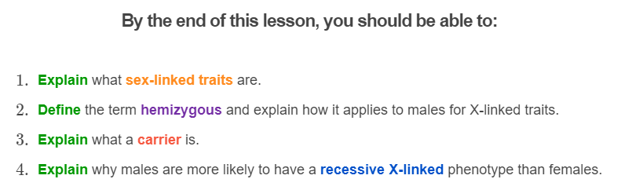


Slide 3
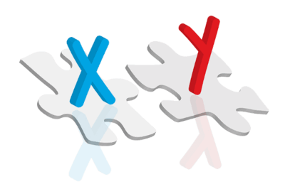
Remember, each of your cells has 46 chromosomes.
Two of these are the sex chromosomes. They determine your born sex: male or female. But that is not all they do!
Many of the genes on these chromosomes control other traits that have nothing to do with your sex! We call these traits sex-linked because they are controlled by genes on the sex chromosomes.

Slide 4
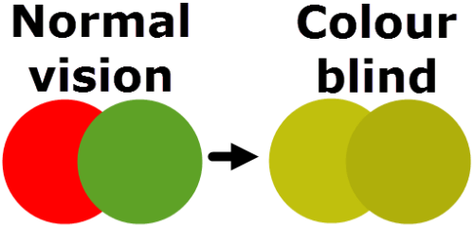
To be clear, sex-linked traits don't have anything to do with your gender.
The term sex-linked just refers to the location of their genes, which is on the sex chromosomes.
Some examples of sex-linked traits are red-green colour blindness and a genetic disease called haemophilia.

Slide 5
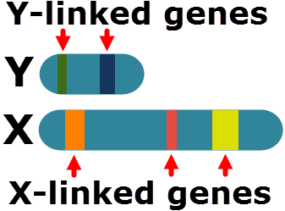
There are two types of sex chromosomes in mammals: the X and the Y chromosomes.
Both of these chromosomes contain different genes. The genes on the X chromosome are called X-linked. The genes on the Y chromosome are called Y-linked.
The X chromosome contains more genes, making it the larger of the two chromosomes.

Slide 6
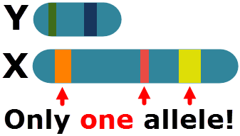
Individuals with two X chromosomes are born female and individuals with one X and one Y are born male.
Because males have only one X chromosome, they only have one copy of each X-linked gene. This only allows them to carry one allele for each of these genes, making them hemizygous.
Remember, genes are lengths of DNA that contain information about a characteristic. Alleles are different versions of a gene. They carry different information about the same characteristic.

Slide 7
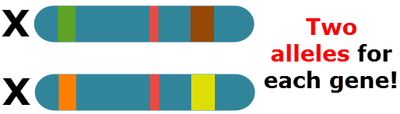
Females have two X chromosomes which allows them to carry two alleles for X-linked genes.
A female with two copies of the same allele is homozygous. If they have two different alleles, they are heterozygous.

Slide 8
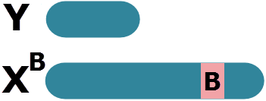
With other genes, alleles have been referred to using capital and lower case letters.
However, sex-linked alleles use a special notation. Each allele is still assigned a letter, but we also make note of which sex chromosome they are found on!
To show an allele is on the X chromosome, we write a large X. We then place the letter representing that allele in the upper right corner of the X, like so: XB.
To indicate an individual has a Y chromosome, which lacks that gene, we write a large Y without any letter in its upper right corner.

Slide 9
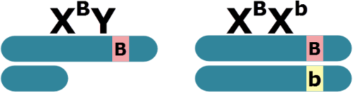
For example, let's say Ruby is heterozygous for a gene that is carried on the X chromosomes.
She would have an allele on one X chromosome represented by a B (dominant) and an allele on the other X chromosome represented by a b (recessive).
This means that her genotype is X^{B}X^{b}.
A male with the B allele on his X chromosome has the hemizygous genotype X^{B}Y.

Slide 10
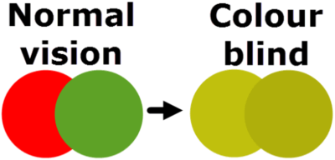
Sex-linked genes can have dominant/recessive interactions!
For example, there is a gene on the X chromosome that controls colour vision. The dominant allele X^{N} gives you normal colour vision. The recessive allele X^{n} gives you red-green colour blindness. An individual with the genotype X^{N}X^{n} will have normal colour vision.

Slide 11

Because males have only one allele for X-linked genes, it does not matter if their alleles are dominant or recessive.
This gives X-linked traits a special pattern of inheritance.
For example, a male with an allele for colour blindness (X^{n}Y) will be colour blind. Similarly, a male with an allele for normal vision (X^{N}Y) will have normal colour vision.

Slide 12
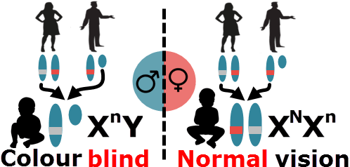
This means that males only need to inherit one copy of the recessive allele to have the recessive phenotype.
They will always inherit this allele from the mother, as males receive their X chromosome from their mother and their Y from their father. In comparison, females need to inherit the recessive allele from both parents to have the recessive phenotype.
This means it is more common for males to have a recessive X-linked phenotype!

Slide 13
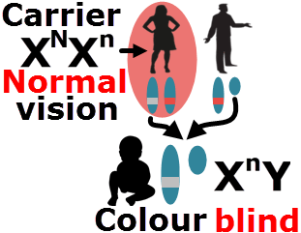
Some females can be called carriers.
Carriers are heterozygous individuals who have one dominant and one recessive allele. As a result, they show the dominant phenotype, but possess a recessive allele that they can pass on to their offspring.
Being a carrier is important because your offspring could have the recessive phenotype even if you and your partner do not!

Slide 14
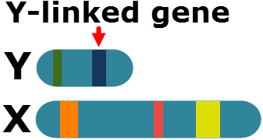
There are also some diseases that are controlled by genes on the Y chromosome.
These Y-linked diseases can only be inherited by males, since only males have a Y chromosome!
Y-linked genes are not talked about as often because there are fewer genes on the Y chromosome. This means there are fewer Y-linked diseases than X-linked diseases.

Slide 15
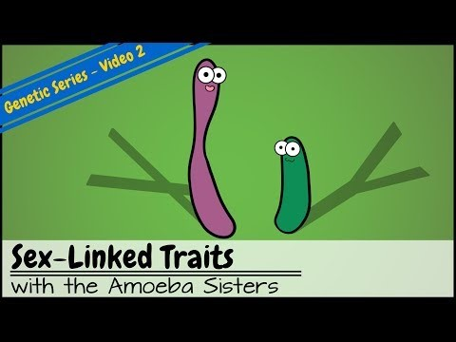

Slide 16
In summary:
• | Males have only one allele for X-linked genes. If this allele is recessive, they cannot hide it, so will have the recessive phenotype.
• | Females have two alleles. If they are heterozygous, their dominant allele will hide the recessive allele. These females are called carriers.
• | This means it is easier for males to inherit a recessive X-linked phenotype.

